Slide 1

An Economist’s Journey through Data Science
How to adapt econometric and analytical skills for a career in Data Science

Slide 2
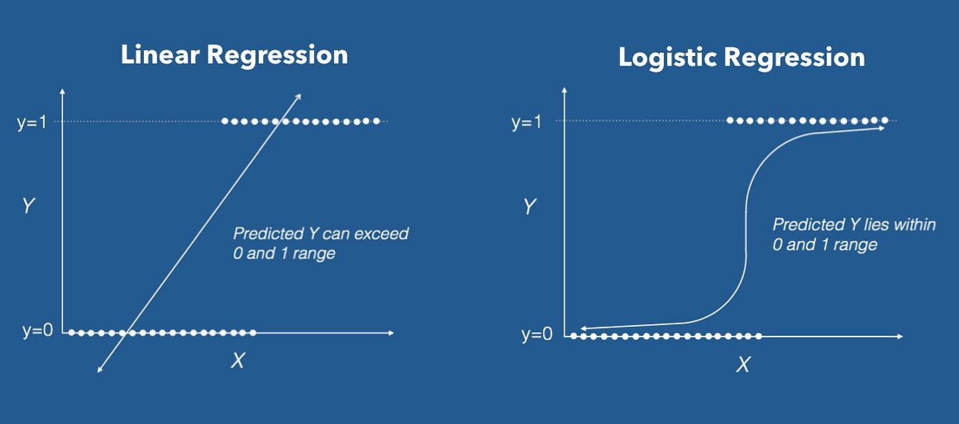
Skills you should leave this program with
Ability to think critically about data
Deep curiosity about data
Statistical thinking
Gaussian curves
Linear and Logistic Regression
Time-series forecasting
Basic to intermediate programming skills
Python
SQL
R

Slide 3
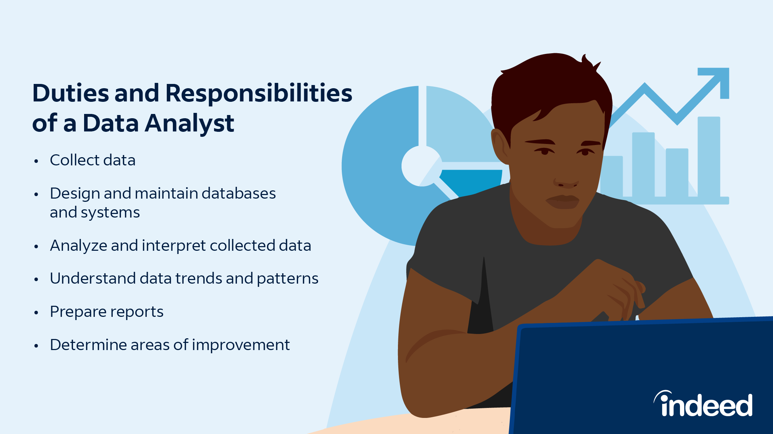
Jobs to look for to begin Data Science journey
Entry-level Data Analyst positions
From this position, you will probably branch off into one of two directions—towards the more managerial side or towards the more technical side
I’m gearing this presentation to those who feel compelled towards the more technical side, but everyone will be able to get something out of it
If you feel connected to the technical aspects, use your entry-level job as an opportunity to develop skills. Change Excel projects to Python projects, explore managing projects using GitHub, etc.
You can then leverage the technical skills learned in the entry-level position to work toward a career in Data Science or Data Engineering

Slide 4
Skills to Develop
Git
Storing code
Version control
Package releases
Better programming skills
You should be comfortable enough with Python and SQL that you don’t feel like you are just copying and pasting code and changing things blindly to survive through projects
Ability to think strategically about your projects
You shouldn’t feel like every project is a fire drill. Rather, you should think of projects as an opportunity to build long-term infrastructure
Even projects with a tight deadline can be returned to and refined before the next time it or something similar to it is asked for
Always think about how you can set up your analyses to allow changes because useful results almost always elicit follow-up questions and requests for modifications
Ability to avoid point-and-click interfaces (like Excel)

Slide 5
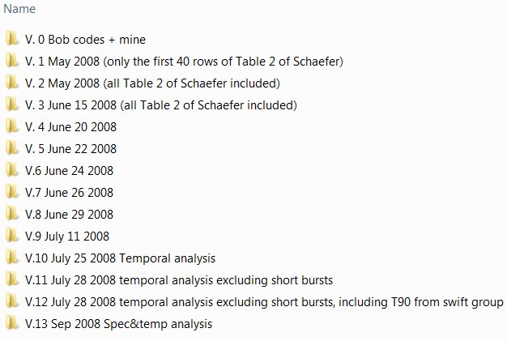
Bad Version Control

Slide 6
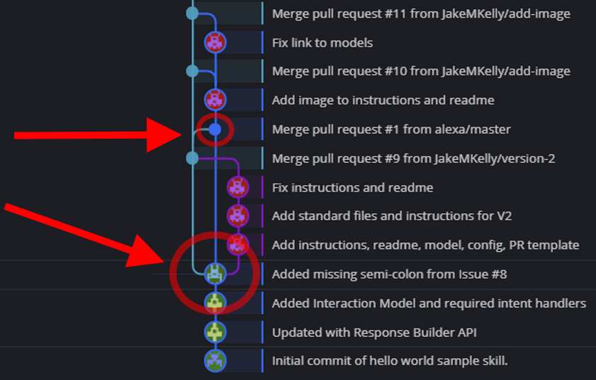
Good Version Control

Slide 7
Good Project Maintenance Practices
Projects are repeatable and written in code
Projects are version-controlled using Git
Projects are well-documented
Readmes, diagrams, flow charts explain exactly why the project exists and what it does
The more difficult the project is to decipher, the worse it is in the long run
Code is configurable
Configuration means changing key parameters in one easy-to-find location
Consider using a config file (config.py, config.yaml, config.ini, etc.)
Code is modularized
Every section or chunk of the code is wrapped in a function that can potentially be re-used for other projects
Sections of the project are imported and called sequentially in a main file until the final result is derived
Code is maintained in one location
More locations for changing key variables increases the risk of human error exponentially
New projects do not begin with copy/paste from other projects

Slide 8
Example Project
https://github.com/mikekeith52/a_simple_project

Slide 9
Miscellaneous Data Science Tools
Jupyter Notebooks (Anaconda or VS Code)
Stackedit.io for Markdown
Black coding style
GitHub
GitHub Desktop for managing projects locally and without command line
Virtual environments
Command line/terminal commands

Slide 10
Further Study
LinkedIn Learning
Essentials of Python
DataCamp
SQL 1 and 2
Python for Data Science

Slide 11
Advanced Concepts
If you want to stick out as a candidate, think about how you would answer the following questions:
In table A, you have information about an organization’s clients. Each row is specific to a client. In table B, you have information about transactions. Each row is specific to a transaction. How do I join these two tables together such that I only join in information about each client’s most recent transaction?
In table A, you have transactions laid out by each item and the wholesale amount of each item within the transaction. In table B, you have transactions laid out by total amounts after all discounts are applied. Each row is a unique transaction and represents how much the client actually paid. How do you re-apply the totals from table B to table A to price each item after the discounts are applied?
How can you forecast the sales of 100 different products each month?
If you are in charge of creating data dictionaries for the tables in your database, how can you structure the project such that you only have to write definitions for columns once, no matter how many tables they appear in? How can you make the dictionary automatically update with new column information every time a table is modified?

